Slide 1
Automatic Physical Database Tuning: A Relaxation-based Approach
Betül Demiröz

Slide 2
Introduction
DBMS applications have become increasingly complex
  combinatorial explosion of physical structures to consider
  structures interact with each other
    the problem cannot be divided into simpler, independent sub-goals
To reduce DBMS’s total cost, automated physical design tools are used

Slide 3
Automatic Physical Design Problem - I
W = workload of representative queries and updates
B = space constraint
Find the set of physical structures that
  finds lowest estimated execution cost of queries in W
  fits in B

Slide 4
Automatic Physical Design Problem - II
Aim
  Handle large workloads and multiple kinds of physical structures
Recent Techniques
  Very complex
  Difficult to analyze and extract properties
Proposed Technique
  Simple, complexity is reduced
  Gives comparable recommendations

Slide 5
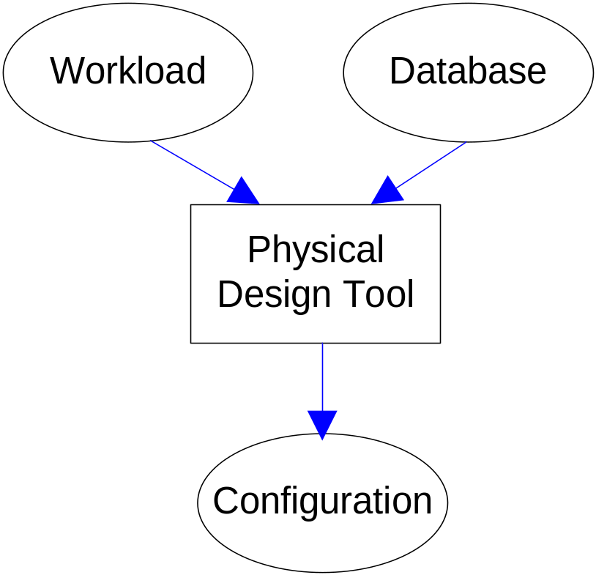
Problem Statement
Set of physical structures (i.e., indexes and views) that make similar workloads execute as fast as possible

Slide 6
Automated Selection of Physical Design
Recent Solutions
  Candidate access paths are heuristicly chosen
  Bottom-up search is used to identify the best overall configuration
Proposed Solution
  Indexes and views are recommended
  Reduces assumptions and heuristics

Slide 7
Recent Techniques
What-If API
  Determine impact without actually materializing physical design
Dependence on the optimizer
  Keep optimizer and its cost model in sync with the tuning process
Search Framework
  Find a good set of candidate structures
    Indexes and views
  Augment the initial candidate set by merging two or more candidates together
  Search the augmented space
    Bottom-up techniques are used
    Greedy algorithm or knapsack and subsequent random permutations

Slide 8
Database Tuning
Workload
Compress Workload
…
Candidate Selection
(per query)
Query Optimizer
Tuning
Client
What-if
API
Database
Server
Metadata
Merging
Enumeration
Yes
Time?
- Create Hypothetical Index/View.
- Optimize Query with respect to hypothetical configurations.
No
Recommendation

Slide 9
Proposed Technique - I
Agrees with what-if API and dependence on the optimizer
Changes search framework
  Find a good set of candidate structures
    For complex queries, candidate structures can be very large
    Bound on the maximum number of candidate structures to consider per query and rank the candidates using heuristics
  Combine merging and enumeration steps
    Generate many alternatives during merging not to miss good solutions
    Put some constraints over merged structures to avoid large growth

Slide 10
Proposed Technique - II
A small set of physical structures are identified
  structures are guaranteed to result in an optimal configuration
A different search technique is used
  opposite of bottom-up search
  start with a large configuration
    time-wise optimal but too large to fit in the available storage
  shrink it using transformations
  advantages: quality and performance

Slide 11
New Architecture
Workload
…
Requests
API
Query Optimizer
Get Optimal Configuration
(per query)
Request Identification
Tuning
Client
Database
Server
What-if
API
Relaxation
Yes
Time?
Metadata
No
Recommendation
Instrumenting the query optimizer.
Search strategy based on relaxations.

Slide 12
Instrumenting the Query Optimizer
Optimization of a single query
Plan is an instance of a template tree that
  has one or more index seeks at the leaf nodes
  combines the leaf nodes by binary intersections or unions
  applies rid lookup to retrieve missing columns
  applies filter operator for non-sargable predicates
  applies a sort operator to enforce order
Applicable to view requests, too

Slide 13
Alternative Index Strategies
Sort (D)
Filter (A+C = 8)
Sort (D)
Lookup(I_{clustered})
Filter (A+C = 8, B < 10)
∩
Lookup(I_{clustered})
Seek (I_{A} < 10)
Seek (I_{B} < 10)
Seek (I_{A} < 10)
(a)
(b)
Filter (A < 10 Λ A+C = 8 Λ B < 10)
Scan (I_{D,A,B,C,E} )
(c)

Slide 14
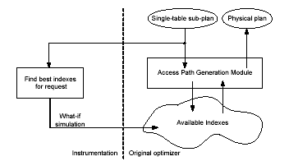
Overview of the Query Optimizer

Slide 15
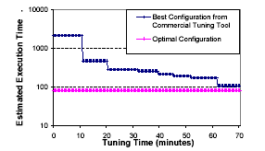
Bounding the improvement

Slide 16
Relaxation-based Search
Relaxing a configuration is replacing some structures by smaller but less efficient ones
Advantages
  merging and enumeration steps are interleaved. Merged structures are obtained lazily, on demand
  re-optimizing a relaxed configuration to evaluate its cost is more efficient
    C₁ has an index on (a,b)
    C₂ has an index on (a,d)
    Replace C₁ and C₂ with C₃
    C₃ has an index on (a,b,d)
    Re-optimize queries that used relaxed structures
    Bottom-up strategy; re-optimize all queries that reference the index table
  provides more useful information to the DB administrator
    good configurations are iteratively relaxed
    at the end of tuning process, we have many alternatives

Slide 17
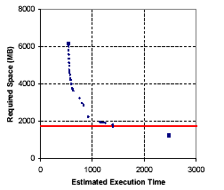
Sample Tuning

Slide 18
Relaxing Configurations
Replacing a subset of its indexes and views
Resulting configuration is
  smaller at the cost
  less efficient
Progressively relaxing configurations results with the optimal configuration
  fits in the available space
  slightly less efficient than the initial one
There are two transformations
  index transformations
  view transformations

Slide 19
Index Transformations - I
Merging
  obtain the best index I_{1,2} that can answer all requests either I₁ or I₂ makes
    I₁ = ([a,b,c];{d,e,f}) and I₂ = ([c,d,g];{e})
    I_{1,2} = ([a,b,c];{d,e,f,g})
Splitting
  splitting I₁ and I₂ produces I_{C} (common index) and residual indexes I_{R1} and I_{R2}
    I₁ = ([a,b,c];{d,e,f}) and I₂ = ([a,c];{e})
    I_{C} = ([a,c];{e}), I_{R1} = ([b];{d,f})

Slide 20
Index Transformations - II
Prefixing
  obtain an index that can answer arbitrary requests
Promotion to clustered
  any index I over table T can be promoted to a clustered index
Removal
  any index can be removed to obtain a new configuration

Slide 21
View Transformations
Merging
  all information from V₁ and V₂ can be obtained in V_{1,2}
Removal
  any view V can be removed to obtain a new configuration

Slide 22
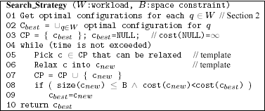
Template for Search Algorithm

Slide 23
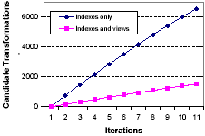
Configurations and Transformations
Relaxing configurations
Transform configurations useful in other configurations
Search space is very large
Crucial to develop good heuristics to guide the search

Slide 24
Estimating Configuration Properties
Critical properties of a given configuration in a physical design problem
  the space the current configuration (C) consumes
  the expected execution cost of the workload when C is available.
To make a good decision on applying the given transformation, we should know
  the amount of space consumption decrease
  the expected execution cost increase
  it is hard to guess these properties

Slide 25
Space Consumption
Space consumed by a configuration is the sum of sizes of all its physical structures
  indexes and views
To estimate the space consumed by an index
  calculate the width of an entry in any node or page
  calculate the number of entries per page and node
The space consumed by a view is estimated as the sum of sizes of each index

Slide 26
Expected Execution Cost
Execution cost of the relaxed configuration can be calculated by
  re-optimizing all queries in the workload in C’ and calculate difference
    very expensive
  re-optimizing the subset of queries in the workload that originally used workloads in C but do not appear in C’
    expected to be efficient, but too costly to estimate the increase in execution cost of each resulting configuration
  simple non-intrusive approach
    can be implemented by simply analysing information

Slide 27
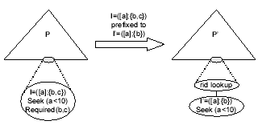
Estimating Execution-cost

Slide 28
Heuristics for Guiding the Research
Penalty estimates the increase in execution cost per unit of storage
  the expected decrease in storage space (T)
  the maximum increase in cost (S)
  penalty = T/S
A reasonable heuristic would result with an increase in the penalty value

Slide 29
Choosing Relaxing Configuration
Choose the configuration with minimal estimated cost
  impractical
  the most efficient configurations require largest amount of space
Another alternative
  if the relaxed configuration does not fit in the available space, further relax it until it is under space constraints
  choose the configuration with highest penalty among all relaxed configurations
  if no candidate configuration is found, choose the configuration with minimum expected cost

Slide 30
Variations and Optimizations
Some minor optimizations and variations
Shortcut evaluation
  remove current configuration if no further improvement can be achieved
Multiple transformations per iteration
  apply more than one transformation to the current current configuration
Shrinking configurations
  remove all indexes and views that are not used to evaluate any query in the workload

Slide 31
Experimental Study
Synthetic and real databases
Hundreds of different workloads
State-of-the-art alternative; Commercial Tuning Tool (CTT)
Physical recommendation metric
  improvement = 100% (1 – cost (W,C_{R}) / cost (W,C_{I}))
  C_{I} = initial configuration, C_{R} = recommended configuration, cost(W,C) = expected cost of evaluating all queries in the workload W under configuration C

Slide 32
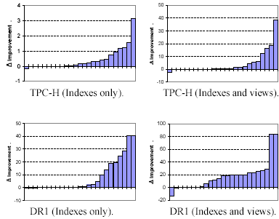
No Constraints - I

Slide 33
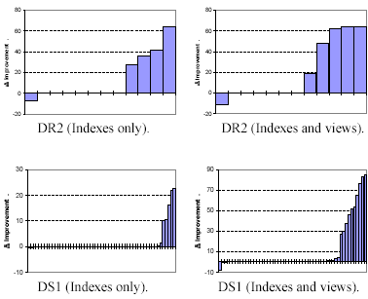
No Constraints - II

Slide 34
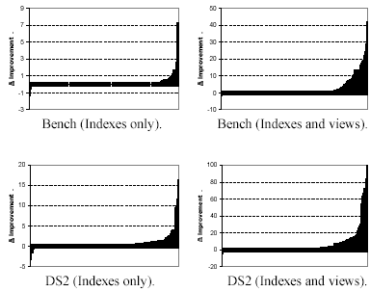
No Constraints - III

Slide 35
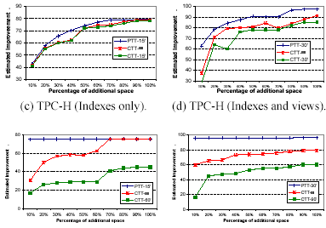
Space Constraints

Slide 36
Conclusion
New automatic physical database tuning technique is proposed
This technique uses a relaxation based search
Reduces assumptions and heuristics
Simple and complexity is reduced
Gives comparable recommendations

Slide 37
Thanks
Any Questions ??

